Slide 1
Synthetic Cannabinoids: Findings from the Community Drug Early Warning System (CDEWS-2)
National Prevention Network Conference
September 13, 2016
Presented by: Amy Billing, M.S.S.A.
This presentation is based on the complete CDEWS-2 report:
Wish, E.D., Billing, A. S., and Artigiani, E.E. (2015). Community Drug Early Warning System: The CDEWS-2 Replication Study. Office of National Drug Control Policy. Washington, DC: Executive Office of the President.
https://www.whitehouse.gov/sites/default/files/ondcp/policy-and-research/finalreport_4_8_15v3.pdf
Center for Substance Abuse Research (CESAR)
University of Maryland, College Park
www.cesar.umd.edu
The information and opinions expressed herein are the views of the authors and do not necessarily represent the views of the Office of National Drug Control Policy (ONDCP) of the Executive Office of the President, or any other agency of the Federal Government

Slide 2
Acknowledgements
Pretrial Services Agency for the District of Columbia
White House Office of National Drug Control Policy
Maryland Governor’s Office of Crime Control and Prevention
Friends Medical Laboratory, Inc. and Clinical Reference Laboratory (CRL)
Armed Forces Medical Examiner System (AFMES) Laboratory
CESAR Colleagues: Eric D. Wish, Ph.D. and Erin Artigiani, M.A.

Slide 3
Purpose of CDEWS
Fill the need for a rapid and low-cost system for identifying emerging drugs at the local community level (ONDCP, 2014)
A useful drug use monitoring system needs to be capable of rapidly responding to newly available drugs and of producing results quickly at minimal cost

Slide 4
CDEWS Methodology
Funded by ONDCP
Collects already obtained urine samples from CJS drug testing programs and hospitals
Selects specimens that tested positive or negative and are ready to be discarded, without regard to age, gender, or charge
Re-test for an expanded panel, including synthetic cannabinoids and new psychoactive substances

Slide 5
CDEWS-2 Goals
Replicate the CDEWS methodology in Washington, DC
Expand CDEWS methodology to new sites and populations
Test all specimens for synthetic cannabinoids
Add a juvenile population

Slide 6
What are Synthetic Cannabinoids?
A blend of herbs and plant material sprayed with one or more synthesized chemical compounds or metabolites that are believed to bind to the same receptors as THC
Sold in small pouches or packets of 0.5-5 grams each as herbal incense or potpourri and often marked as “not for human consumption”
Typically smoked in joints or pipes or ingested in tea
Not detected by standard drug tests

Slide 7
SC Testing Panel for CDEWS-1 & CDEWS-2
Synthetic Cannabinoid Metabolites
Tested for in CDEWS 1
AM-2201
JWH-018
JWH-019
JWH-073
JWH-081
JWH-122
JWH-210
JWH-250
MAM-2201
RCS-4
UR-144
XLR-11
Added in CDEWS 2
APINACA (AKB-48)
5F-AKB-48
BB-22
PB-22
5F-PB-22
AB-PINACA
5F-AB-PINACA
ADB-PINACA
ADBICA

Slide 8
Toxicologists Interviewed for CDEWS-2
Drug Testing Experts
1. Armed Forces Medical Examiner System (AFMES)
2. Washington-Baltimore HIDTA
3. Cayman Chemical
4. NMS Labs
5. Arkansas Public Health Laboratory, Arkansas Department of Health
6. U.S. Drug Enforcement Administration (DEA) Western Lab
7. Addiction Research and Treatment Services, University of Colorado Denver
8. Rocky Mountain HIDTA
9. National Institute on Drug Abuse, National Institutes of Health Biomedical Research Center
10. Denver Office of Drug Strategy & Denver CEWG
11. U.S. Drug Enforcement Administration (DEA), Denver Division
12. Pretrial Services Agency for the District of Columbia
13. U.S. Drug Enforcement Administration (DEA), Field Intelligence, Denver Division
14. Friends Medical Laboratory
15. Denver Police Department Crime Laboratory

Slide 9
CDEWS Limitations
CDEWS provides a snapshot of the relative recent use of tested drugs in the tested populations; results are not generalizable to all offenders.
Persons being tested by CJS monitoring programs are typically at high risk for drug abuse and do not represent the greater population from which they come; However, drug trends in high risk criminal justice populations may foreshadow drug use trends that show up later in the general population.
Lengthy holding times due to legal requirements may have resulted in the degradation of some specimens, making it less likely to detect certain drugs such as new psychoactive substances (Huestis, 2013).
Urine tests alone cannot determine whether or not a prescription drug was used under medical supervision. Rather, CDEWS can best be viewed as providing timely information about local drug use and availability that can be used to target communities where additional information may be collected.

Slide 10
CDEWS Study Sites
CDEWS-1 (2013)
CDEWS-2 (2014)
Washington, DC – adult parolees/probationers
Washington, DC – pretrial surveillance
Washington, DC – lockup
Virginia – Chesterfield Community Corrections Services (Probation)
Maryland - Prince George’s County Drug Court
Washington, DC – adult parolees/probationers
Washington, DC – juvenile detainees
Denver, CO – adult drug court participants
Tampa, FL – Juvenile Assessment Center (JAC) Program detainees

Slide 11
CDEWS-1 Metabolites Found in All Synthetic Cannabinoid Positive Specimens from Five CJS Populations in Three Sites, 2013 (N=118)
Source: Wish, E.D., Artigiani, E.E. and Billing, A. S. (2013). Community Drug Early Warning System: The CDEWS Pilot Project. Office of National Drug Control Policy. Washington, DC: Executive Office of the President.

Slide 12
Metabolites Found In All Synthetic Cannabinoid Positive Specimens, By CDEWS-2 Population, 2014
 | Adult Parole & Probation – Washington, DC (N=70)*† |  | Juvenile Family Court – Washington, DC (N=38)^ |  | Adult Drug Court – Denver, CO (N=19)*‡ |  | Juvenile Assessment Center – Tampa, FL (N=10)⁺
(Dates SC positives collected) | (12/5/13-3/18/14) |  | (5/21/14-7/30/14) |  | (8/25/13-2/12/14) |  | (9/20/14-10/31/14)
Metabolites Detected
UR-144 | 99% |  | 71% |  | 53% |  | 100%
PB-22 | 41 |  | 5 |  | 37 |  | 0
5F-PB-22 | 13 |  | 21 |  | 21 |  | 0
XLR-11 | 4 |  | 26 |  | 11 |  | 0
AKB-48 | 1 |  | 0 |  | 0 |  | 0
MAM-2201± | 0 |  | 0 |  | 32 |  | 0
JWH-018 | 0 |  | 3 |  | 32 |  | 0
JWH-122 | 0 |  | 0 |  | 21 |  | 0
JWH-073 | 0 |  | 3 |  | 11 |  | 0
AB-PINACA | 0 |  | 13 |  | 5 |  | 0
ADBICA± | 0 |  | 0 |  | 5 |  | 0
5F-AB-PINACA± | 0 |  | 3 |  | 0 |  | 0
Number of Above Metabolites (of 12) Detected
1 | 57% |  | 68% |  | 63% |  | 100%
2 | 30 | 43% | 24 | 32% | 11 | 37% | 0
3+ | 13 |  | 8 |  | 26 |  | 0
Total | 100% |  | 100% |  | 100% |  | 100%

Slide 13
Metabolites Identified in SC Positive Specimens from Washington, DC, CDEWS-1 and CDEWS-2 Studies
 | CDEWS-1 Three Adult CJS Populations (N=107)* | CDEWS-2 Adult Parole/Probation Population (N=70)
Percentage Positive For:
UR-144 | 95% | 99%
XLR-11 | 38*** | 4***
JWH-018 | 5 | 0
JWH-073 | 1 | 0
PB-22 | Not Tested | 41
5F-PB-22 | Not Tested | 13
AKB-48 | Not Tested | 1

Slide 14
CDEWS-1 Percentage of Specimens from Three DC CJS Male Populations Combined Testing Positive for Synthetic Cannabinoids, by PSA Drug Screen Result and Age, 2013 (N=341 specimens from Washington, DC Parole & Probation, Pretrial Surveillance and Lockup)
Source: Wish, E.D., Artigiani, E.E. and Billing, A. S. (2013). Community Drug Early Warning System: The CDEWS Pilot Project. Office of National Drug Control Policy. Washington, DC: Executive Office of the President.

Slide 15
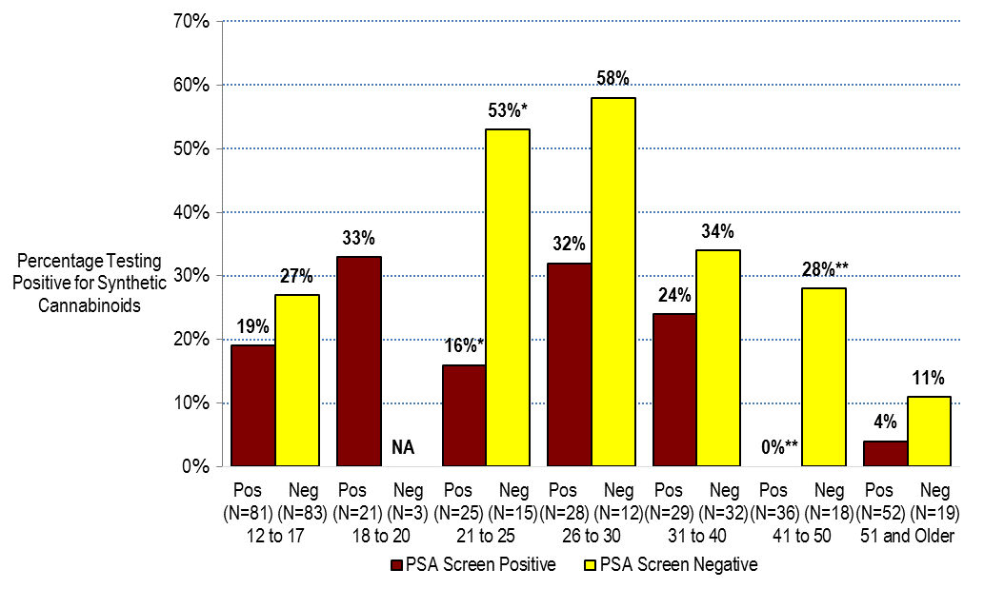
CDEWS-2 Percentage of Specimens for Adult Male DC Parolees/Probationers and Juvenile Males Testing Positive⁺ for Synthetic Cannabinoids, by PSA Drug Screening Result and Age, 2014 (N=453)‡

Slide 16
Implications of CDEWS Findings
Drug testing programs should weigh the value of adding SC metabolites to their testing protocols and adopting an annual CDEWS type of process for reviewing and updating the drugs included in their testing protocols.
While we studied only criminal justice populations, the CDEWS results may also have implications for expanded testing of urine specimens collected in hospital, physician, military, and workplace environments to accurately identify drugs recently used.
The high level of SC use detected suggests that local public health systems should implement targeted prevention campaigns to educate the public about the rapidly changing ingredients in products sold as synthetic cannabinoids and the potential harm that can result from their use.
Source: Wish, E.D., Artigiani, E.E. and Billing, A. S. (2013). Community Drug Early Warning System: The CDEWS Pilot Project. Office of National Drug Control Policy. Washington, DC: Executive Office of the President.

Slide 17
CDEWS-3 Testing Panel (Testing conducted by the Armed Forces Medical Examiner System Laboratory)
GENERAL PANEL
1 | 6-Acetylmorphine | 41 | Hydroxyzine
2 | 7-Aminoclonazepam | 42 | Ketamine
3 | Acetylfentanyl | 43 | Lorazepam
4 | Alprazolam | 44 | MDA
5 | Amitriptyline | 45 | MDEA
6 | Amphetamine | 46 | MDMA
7 | Atomoxetine | 47 | Meperidine
8 | Benzoylecgonine | 48 | Methadone
9 | Bupropion | 49 | Methamphetamine
10 | Carisoprodol | 50 | Methylphenidate
11 | Cetirizine | 51 | Morphine
12 | Chlorpromazine | 52 | Naloxone
13 | Citalopram | 53 | Nordiazepam
14 | Clonazepam | 54 | Norfentanyl
15 | Codeine | 55 | Normeperidine
16 | Cyclobenzaprine | 56 | Nortriptyline
17 | Demoxepam | 57 | Oxazepam
18 | Desalkflurazepam | 58 | Oxycodone
19 | Desmorphine | 59 | Oxymorphone
20 | Desmethylvenlafaxine/Desvenlafaxine | 60 | Paroxetine
21 | Dextromethorphan | 61 | PCP
22 | Diazepam | 62 | Phenmetrazine
23 | Diclazepam | 63 | Phenazepam
24 | Doxepin | 64 | Prazepam
25 | Duloxetine | 65 | Promethazine
26 | EDDP | 66 | Pseudoephedrine
27 | Ephedrine | 67 | Pyrazolam
28 | Estazolam | 68 | Propoxyphene
29 | Etizolam | 69 | Quinidine
30 | Fentanyl | 70 | Quinine
31 | Flubromazepam | 71 | Sertraline
32 | Flunitrazepam | 72 | Tapentadol
33 | Fluoxetine | 73 | Temazepam
34 | Flurazepam | 74 | Thioridazine
35 | Haloperidol | 75 | Tramadol
36 | Hydrocodone | 76 | Venlafaxine
37 | Hydromorphone | 77 | Zaleplon
38 | a-Hydroxyalprazolam | 78 | Zolpidem
39 | a-Hydroxymidazolam | 79 | Zopiclone
40 | a-Hydroxytriazolam
SYNTHETIC CANNABINOID PANEL
1 | JWH-018-5-COOH
2 | JWH-019-6-OH
3 | JWH-073-4-COOH
4 | JWH-081-5-OH
5 | JWH-122-5-OH
6 | JWH-210-5-OH
7 | JWH-250-5-OH
8 | AM2201-4-OH
9 | MAM-2201-5-COOH/JWH 122 COOH
10 | RCS-4-5-COOH
11 | UR-144-5-COOH
12 | XLR-11-4-OH
13 | AKB-48 COOH
14 | 5F AKB-48 metabolite
15 | BB-22 metabolite
16 | PB-22 Carb Indole
17 | 5F PB-22 Carb Indole
18 | AB-PINACA
19 | 5F AB PINACA
20 | ADB-PINACA-5-COOH
21 | ADBICA-5-COOH
22 | AB-FUBINACA (Parent)
23 | AB-CHMINACA (Parent)
24 | AB-CHMINACA metab 4
25 | AB-CHMINACA metab 6
26 | ADB-FUBINACA (Parent)
27 | 5F-AMB
28 | MAB-CHMINACA
DESIGNER STIMULANT PANEL
1 | 25B-NBoMe
2 | 25I-NBoMe
3 | 25C-NBoMe
4 | 2C-B
5 | 2-Fluoroamphetamine
6 | 2-Fluoromethamphetamine
7 | 3-Fluoromethcathinone
8 | 4-Methylethcathinone (4-MEC)
9 | Buphedrone
10 | Butylone
11 | Benzylpiperazine
12 | Cathinone
13 | Methcathinone/Ephedrone
14 | Ethylone
15 | Eutylone
16 | mCPP
17 | MBDB
18 | MDPV
19 | a-PVP
20 | Mephedrone
21 | Methedrone
22 | Methylone
23 | Pentedrone
24 | Pentylone
25 | TFMPP
26 | Phentermine
27 | B-Methylphenethylamine
28 | Trazodone
29 | Phenmetrazine
30 | Naphyrone
31 | Mitragynine
32 | Methoxetamine
33 | PMMA
34 | 2C-T-7
35 | Flephedrone
36 | AH-7921
37 | Methiopropamine
THC/BARBS/LSD/ BUPRENORPHINE PANEL
1 | THC-COOH
2 | Amobarbital
3 | Butalbital
4 | Pentobarbital
5 | Phenobarbital
6 | Secobarbital
7 | Buprenorphine
8 | Norbuprenorphine
9 | Naloxone
10 | LSD

Slide 18
CDEWS-3 Overview
Study sites include:
HOPE Probation program in Honolulu, HI
2 Midwest prison inmate populations
DC Parole and Probation program
Maryland Parole and Probation program
Findings from our Hawaii site and all previous reports can be found at: https://www.whitehouse.gov/ondcp/research-and-data

Slide 19
Sources for Tracking Emerging Drug Trends
National Drug Early Warning System (NDEWS) Network – www.ndews.org
CESAR FAX Synthetic Cannabinoids Series – www.cesar.umd.edu
National Institute on Drug Abuse (NIDA) - http://www.drugabuse.gov/
DEA Office of Diversion Control National Forensic Laboratory Information System (NFLIS) – www.nflis.deadiversion.usdoj.gov/NFLISHome.aspx
American Association of Poison Control Centers (AAPCC) Alerts – www.aapcc.org
United Nations Office on Drugs and Crime, Early Warning Advisories and other reports – www.unodc.org
NMS Lab Reports and Webinars – www.nmslabs.com and http://www.designerdrugtrends.org/
Scientific Working Group for the Analysis of Seized Drugs (SWGDRUG) - http://www.swgdrug.org/monographs.htm
European Monitoring Centre for Drugs and Drug Addiction (EMCDDA) – http://www.emcdda.europa.eu/

Slide 20
CESAR is LOOKING for SITES for CDEWS-5
Population that is already being drug tested by a program or organization
CJS or patient population
No cost to the participating site
All specimens will be de-identified before transfer to CESAR
Participating sites will get an idea of what drugs their population is using that are not part of their testing panel

Slide 21
Contact Information
Eric Wish
Director, CESAR
ewish@umd.edu
Amy Billing
Faculty Specialist, CESAR
billing@umd.edu

